Slide 1
Bizloan Sales Buddy App.

Slide 2
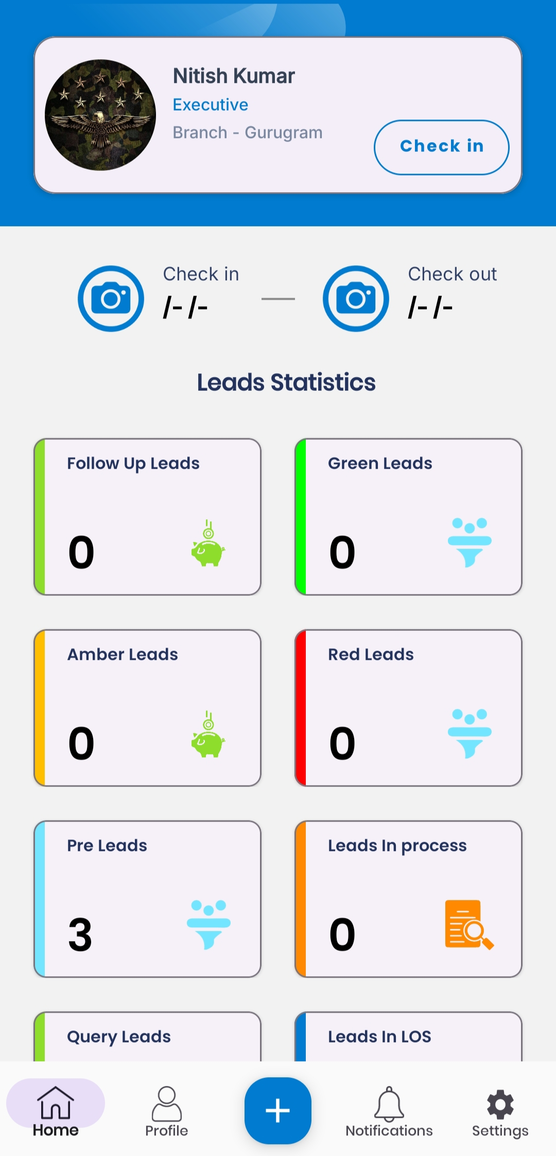
Logging In and Checking In.
After launching the Sales Buddy and logging in with your credentials, the Home screen displays your profile card (name, role, and branch).
To begin your day, tap Check In (located to the right of your profile) and allow the app to capture a photo for verification.
The app will then show your check-in time under Check in and change the button to Check Out.
At the end of your day, tap Check Out and capture a photo to record your departure time.
Open and log in: Launch the app and enter your user credentials. Upon successful login, you will see your profile card on the Home screen.
Check In: Tap the Check In button. The camera will open; take a clear photo of yourself or your surroundings as prompted. Confirm the photo to complete check-in.
Verify check-in: After a successful check-in, the screen will display your photo and the current time under Check in. The Check Out button will appear.

Slide 3
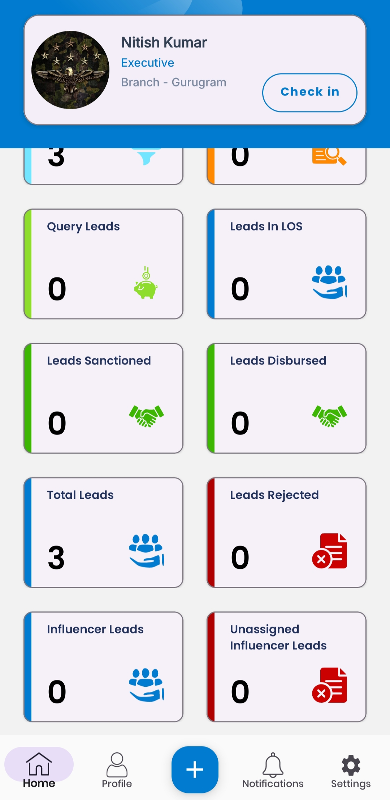
Navigating the Dashboard
The Home screen includes a Leads Statistics section showing key metrics at a glance. Each metric is displayed in a colored panel with an icon. Use these to monitor your pipeline: - Follow Up Leads: Number of leads flagged for follow-up contact (green icon).
  Green Leads: High-priority or high-probability leads (green color-coded funnel icon).
  Amber Leads: Medium-priority leads (yellow icon).
  Red Leads: Low-priority or problem leads (red icon).
  Pre Leads: Preliminary inquiries or pre-qualified leads (blue icon).
  Leads In Process: Leads currently being processed by the system (orange icon with document).
  Query Leads: Leads with pending queries or issues (light green icon).
  Leads in LOS: Leads which are moving in LOS.
  Leads Sanctioned: Which are sanctions in LOS.
  Leads Disbursed: Leads for which funds have been disbursed.
  Total Leads: Total number of leads in Sales Buddy app.
  Influencer Leads: Influencer Leads which is assigned by respected BM.
  Unassigned Influencer Leads: Influencer Leads not assigned yet.

Slide 4
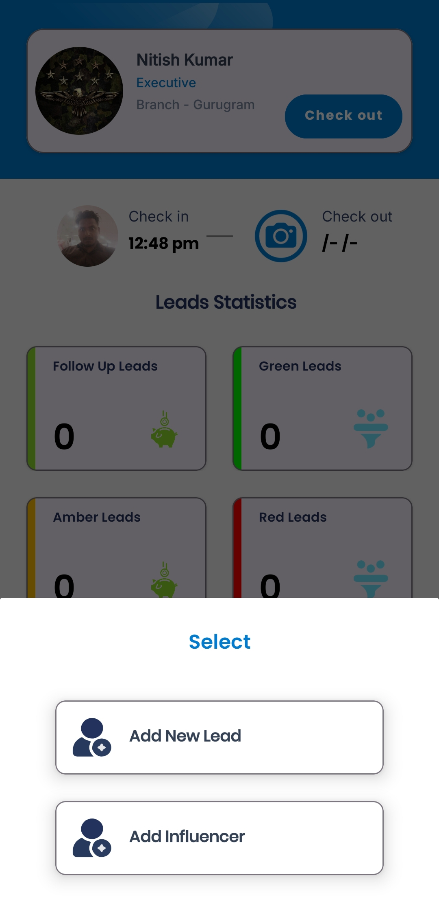
Adding New Leads.
To add a lead, tap the blue + button at the bottom center of any screen. A Select menu will pop up. Choose
Add New Lead to create a standard customer lead.
Step 1: On the Home screen, tap the + (Add) button .
Step 2: In the Select menu that appears, tap Add New Lead (person icon) to proceed with a new lead.
Step 3: The app will navigate to the Visit Detail form to begin capturing information about your visit and the lead.

Slide 5
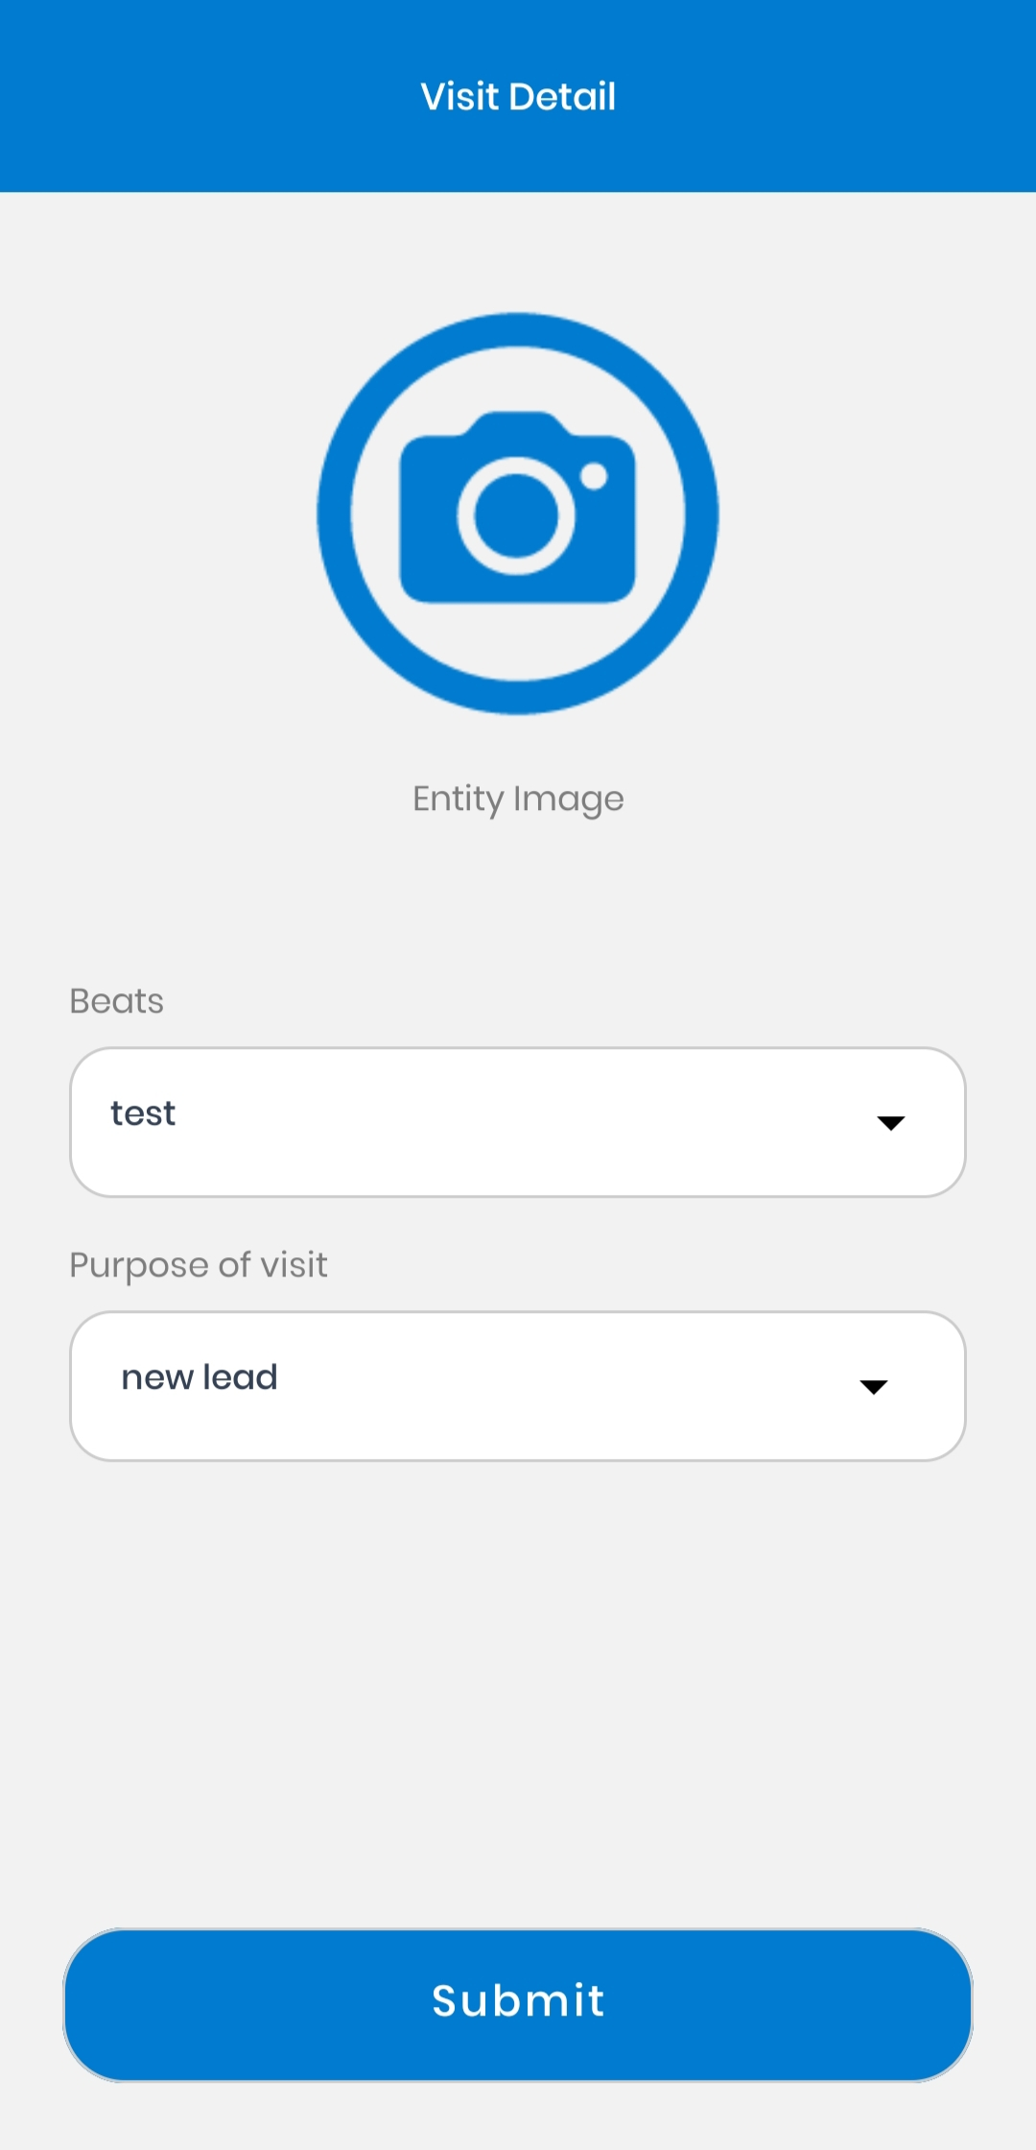
Completing the Visit Detail Form.
After selecting Add New Lead, you land on the Visit Detail screen. Complete the form as follows: - Entity Image: Tap the camera icon or image placeholder to take or upload a photo of the place or person visited. This serves as visual verification of the visit.
  Beats: Tap the dropdown to select your sales area or route (for example, "test" in the screenshot). This categorizes where the visit took place.
  Purpose of Visit: Tap the dropdown to select why you are visiting (e.g. New Lead, Follow Up, etc.). In this example, "new lead" is selected.
  Submit: When all fields are filled, tap the Submit button at the bottom. This saves the visit details and advances you to the lead entry process.
  Capture Photo: Ensure the photo clearly shows the visit entity or yourself. Confirm and save the image.
  Select Beat: Choose the appropriate sales beat or region for this visit. Choose Purpose: Indicate the reason for the visit from the list.
  Submit: Tap Submit to confirm. The app will validate entries and proceed to the next screen.

Slide 6
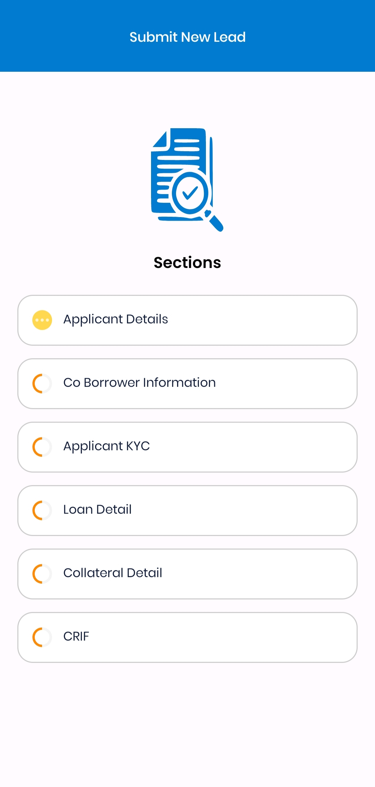
Submitting a New Lead
You will now see the Submit New Lead screen with multiple Sections to complete. Tap each section in order and fill in the required details. The app shows a progress icon next to incomplete sections (yellow/ orange circle). Complete all sections fully before final submission: - Applicant Details: Enter the lead’s personal information (name, contact number, address, etc.).
  Co-Borrower Information: If applicable, enter information for a co-applicant or spouse. If none, leave blank or indicate None.
  Applicant KYC: Upload or capture identity documents (such as ID proof, address proof) as required. Ensure the images are clear and legible.
  Loan Detail: Specify the loan requirements, including type (home, auto, etc.), desired amount, and tenure.
  Collateral Detail: Provide details of any collateral or security offered by the applicant (property, vehicle, etc.).
  CRIF: Retrieve the applicant’s credit report or score (often a PDF or system-fetched data).
Once you have filled all sections ,tap Submit at the top or bottom of the screen to send the new lead for processing. - Step-by-Step: For each section, enter all mandatory fields. You can tap Next or the section name to navigate. Review your entries for accuracy.
  Final Submission: After completing CRIF and ensuring all sections are complete, use the Submit action. You should see a confirmation message (e.g., “Lead submitted successfully”). If any required information is missing, the app will highlight the specific fields or prompt an error.

Slide 7
Influencer App Flow.

Slide 8
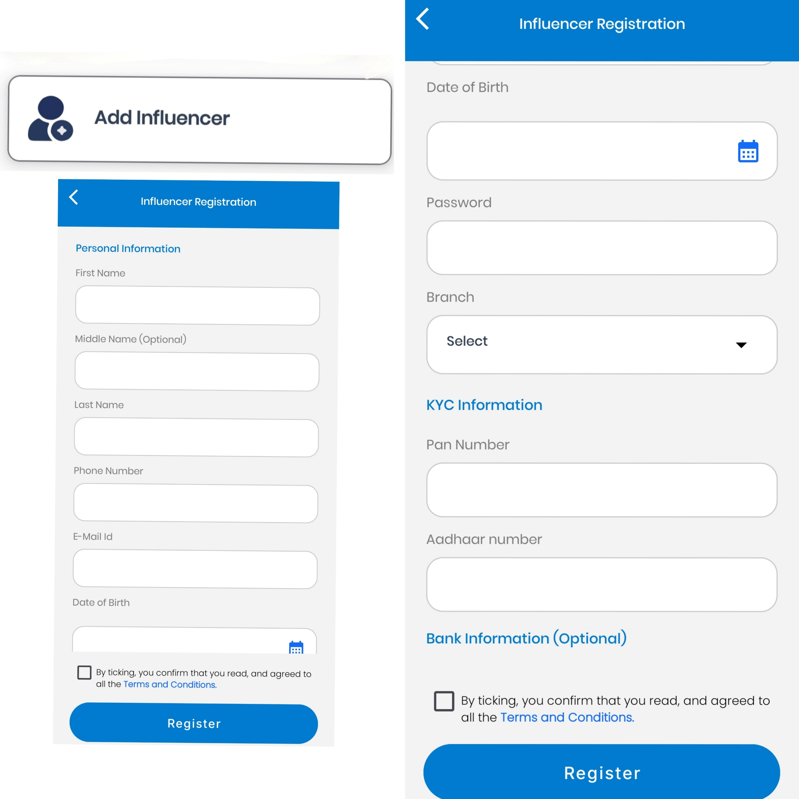
Influencer Onboard
Scope:
This SOP covers only the "Add Influencer" feature of the mobile application.
Steps Of Onboard of Influencer :
1. Log into the mobile application.
2. From the dashboard, tap on the "Add Influencer" button.
3. Fill in the required personal information fields including:
- First Name
- Last Name
- Phone Number
- Email ID
- Date of Birth
- Password
- Branch
4. Enter KYC information:
- PAN Number, Aadhaar Number
5. Optionally enter bank information if required.
6. Tick the checkbox to agree to the Terms and Conditions.
7. Tap the "Register" button to complete the process.

Slide 9
Dashboard Metrics Description.
The dashboard’s color-coded panels help you quickly assess your workload and performance: - Green Leads (green): High-priority leads likely to convert.
  Amber Leads (yellow): Medium-priority leads needing more follow-up.
  Red Leads (red): Low-probability or stalled leads.
  Follow Up Leads: Leads marked for another contact attempt.
  Query Leads (light green): Leads awaiting response to specific questions.
  Pre Leads (blue): New inquiries or partially qualified leads.
  Leads in Process (orange): Leads currently being processed by the loan system.
  Leads in LOS (blue): Leads actively in the loan origination workflow.
  Leads Sanctioned/Disbursed (green): Counts of approved and funded loans.
  Leads Rejected (red): Leads that did not meet criteria.
  Influencer Leads (blue): Leads from influencers, and Unassigned Influencer Leads (red): those not yet assigned to an executive.

